Slide 1

Causality between corporate social performance and financial performance: evidence from canadian firms
Journal of business ethics 2008 - Rim makni, clause Francoeur, François bellavance
f
By Cephas Anna Nathanaëlle GATSE

Slide 2
MOTIVATION
Very few articles include Canadian firms
2004: Introduction of Canadian Social Investment Database (CSID) developed by Michalel Janrzi Research Associates (MJRA)
AIM
Analyze the relationship between CSP and FP
Using the “Granger causality approach”
CSP = Corporate Social Performance
FP = Financial Performance

Slide 3
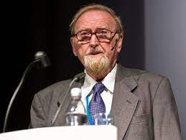
Granger causality approach
Theory developed in 1969 by Clive Granger
A statistical concept based on prediction
f
Clive Granger
1934-2009
What is the difference between regression and Granger causality approach ?
Regression demonstrates the correlation between two or more variables
Granger causality approach argues that the causality in economics could be tested by measuring the ability to predict the future values of a time series using prior values of another time series
B
Course starts at 8:30
Watching TV and examen grade
A
Wake up 7:05
Wake-up 7:00

Slide 4
Theoritical background
Follow the six possible causalities between CSP and FP developed by Preston and O’Bannon (1997)
f
Stakeholder theory: consider the needs of stakeholder
Management opportunism: Use CSP to hide low financial results
Slack resources: More we have high financial performance means more possibility to invest in social actions
Positive synergy: Virtuous circle
The trade-off: Negative impact of CSP on FP
Negative synergy: Vicious circle

Slide 5
Methodology
Sample
168 Canadian Firms
Between 2004 -2005
CSP data are provided by CSID
FP data are provided by Toronto Stock Exchange (TSX)
Variables
Control variables
Firm size
Firm risk
Industry
Corporate Social Performance
Financial Performance
CSP aggregate score
Community & Society
Corporate governance
Employees
Environment
Human rights
Market return
Return on assets
Return on equity
Hypothesis: High (lower) levels of financial performance (corporate social performance) Granger cause higher (lower) levels of corporate social performance (financial performance)

Slide 6
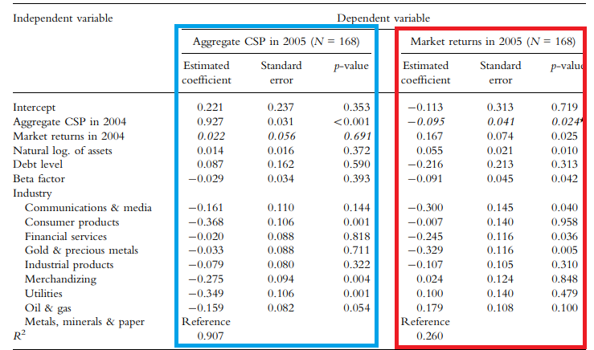
results
Model 1
No statistically significant relation between CSP aggregate score 2005 and FP 2004 measures
The FP don’t Granger cause CSP aggregate score
Model 1: CSP 2005 = ß0 + ß1 *CSP 2004 + ß2 *FP 2004
Model 2: FP 2005 = X0 + X1 *FP 2004+ X2 *CSP 2004
OLS regression models between the CSP aggregate score and FP measures
Model 2
Statistically significant negative relationship between CSP aggregate score and market return
Unidirectional Granger causal relationship
Market reacts negatively facing to a high CSP aggregate score

Slide 7
Results of the different CSP dimensions
Model 1: CSP 2005 = ß0 + ß1 *CSP 2004 + ß2 *FP 2004
Model 2: FP 2005 = X0 + X1 *FP 2004+ X2 *CSP 2004
By using the six elements (community & society score, corporate governance score, employees score, environmental score and human rights score)
Statistically significant relationship between “Employee score” & “Environment score” and FP measures.
Model 2
For “employee score” we find a statistically significant negative relationship (P=0,038) between market return 2005 and Employee 2004
The market reacts negatively when companies invest in their employees

Slide 8
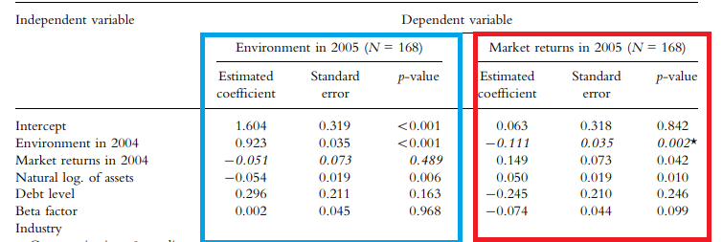
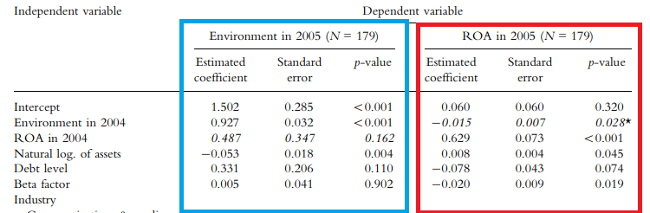
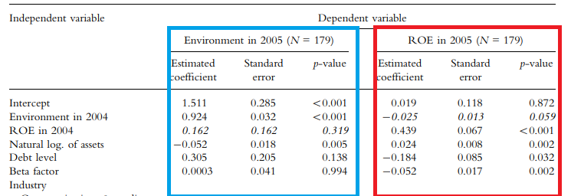
Model 1: CSP 2005 = ß0 + ß1 *CSP 2004 + ß2 *FP 2004
Model 2: FP 2005 = X0 + X1 *FP 2004+ X2 *CSP 2004
OLS regression between environmental score and FP measures
Model 1
No statistically significant relationship
Model 2
Statistically significant negative relationship between stock market 2005 and environmental score 2004
Statistically significant negative relationship between ROA 2005 and environmental score 2004
Statistically significative negative relationship at a level of 10% between ROE and environmental score
Trade-off hypothesis
Negative synergy
Environmental score = FP measures

Slide 9
FINDINGS
Environmental initiatives are too costly for Canadian firms
The gains from these environmental initiatives are too small
The Canadian’s market doesn’t perceive social initiatives like investments but rather like a cost
The Canadian state must provide financial support to help companies to implement various social aspects
LIMITATIONS
The time period chosen does not permit the observation of a change
Due to the short time period selected, the variation between scores is very small
Don’t consider the regulation on industry variable

Slide 10
Thank you

